Slide 1
Luxury furniture in Brussels (Belgium)
Marketing campaign

Slide 2
Agenda
Business Case
The data
The method
Results
Discussion
Conclusion

Slide 3
Business Case
An international seller of luxury furnishing wants to:
launch a marketing campaign in Belgium
create a few stores in Belgium (if it estimates the market is not packed yet of similar stores)
The potential customers share the following features:
Age: 18-44 years
High propensity to buy luxury furniture’s assessed based on housing price
Owner of the housing (these are assumed to be more likely to buy luxury furniture’s)

Slide 4
The data
The explanatory variables we will look at are:
'Population 18-44':
the number of persons in the neighbor(i.e; postal code) which have an age we deem is comprised in our target range
'N_Proprio':
the number of housing owners: we assume housing owners are wealthy people which are likely to invest in high-end furniture (people that rent a place are less likely to buy expensive furniture as we assume they are less likely to stay in their housing for long term)
,'>40KEUR:
the number of people that earn more than 40k€/year in the neighbor. We assume people that earn less are less likely to buy expensive furniture
','AvgPrice':
a measure to assess the propensity and capacity of the population to buy expensive furntirues is the avgprice of their house
we assume the higher the price, the bigger the house and hence the more furniture will be bought.
We assume the higher the price, the richer are the inhabitants

Slide 5
The method
Unsupervised Machine Learning, K-means
Why?
We want to segment the population based on the variables discussed in the previous slide
We do not have any indication on whether their propensity to buy is high or low. This is the reason why we use unsupervised ML technique

Slide 6
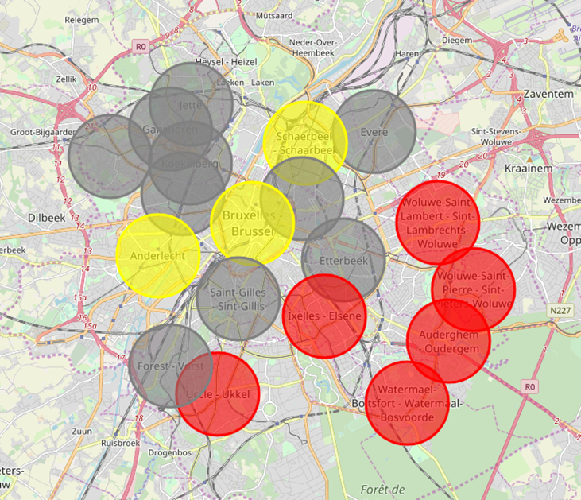
Results(1/2) (cluster of customers)
Label_0 (low potential) : lowest number of young people and do not seem really wealthy: lowest # of 18-44y people, lowest number of proprio lowest # of salary >40kEUR and lowest avg price of houses
Label_1 (med-high potential – YELLOW CIRCLE): Highest number of young people and relatively wealthy (based on avg price of houses)): 1st for young people, first for # owners , first for # of salary >40kEUR but people seem to live in average in less pricy homes ( we assume therefore less propensity to buy expensive furnitures than people in Cluster labelled 2).
Label_2 (high potential – RED CIRCLE): Wealthy (based on avgprice of houses and # of >40kEUR salary) but few young people: above Label 0 for # of young people and number of owners, second for # of salary >40kEUR and first for avg price house
Map of Brussels 20 « Commune »
Commune=Postal code in french

Slide 7
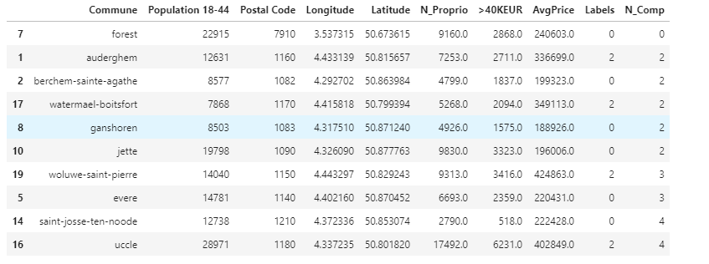
Results(2/2) (Potential competitors)
Commune=Postal code in french

Slide 8
Discussion
Location for the marketing campaign
Yellow cluster vs Red Cluster?
On one hand Label_2 seems to include the most wealthy people, but on the other hand, there is a lower amount of people earning >40k than for Label_1.
Marketing
For the launch of our store, we cannot afford to target several locations. We have to choose one location. So which on to choose?
All in all, we still recommend to target Label_2 neighborhood - as they seem to be the wealthiest and have still a significant amount of population earning >40kEUR .
We recommend to target a location which is close to other Label_2Neigborhood
We recommend to target a location which has low number of competitor in radius 5km
Commune=Postal code in french

Slide 9
Conclusion
Marketing campaign in Red and Yellow Clusters
For the marketing campaign, we can afford to target several locations. Therefore, we will target all neigbors located in Red and Yellow zone.
Launch of a store in ‘Auderghem ’
relatively low number of competitor (only 2) and is clustered in the Label_2 (high potential –red) zone
Commune=Postal code in french

